Slide 1




NEXT GEN EMPLOYABILITY PROGRAM
Creating a future-ready workforce
Team Members
College Name
Student Name : Mithra Y
Student ID : au311121104037
Loyola-ICAM College of Engineering and Technology

Slide 2

CAPSTONE PROJECT SHOWCASE
Project Title
MUSIC WEB APPLICATION USING DJANGO FRAMEWORK
Abstract | Problem Statement | Project Overview | Proposed Solution | Technology Used | Modelling & Results | Conclusion

Slide 3
Abstract -> Recognizing the evolving landscape of digital music consumption, this project endeavors to meet the escalating demand for adaptable and user-centric platforms. -> Leveraging the Django framework, the project aims to craft a dynamic Music Web Application. -> Emphasis is placed on creating an immersive user experience that prioritizes ease of use and accessibility. -> Through seamless integration of functionalities, the application seeks to streamline the process of discovering, organizing, and enjoying diverse music content. -> By fostering user engagement and interaction, the platform aims to cultivate a vibrant community of music enthusiasts. -> The project is driven by a commitment to innovation and continuous improvement, with a focus on staying abreast of emerging trends and technologies in the digital music sphere.
Source :

Slide 4
Problem Statement -> Lack of unified platform: The digital music landscape lacks a single platform that offers comprehensive features for users to discover, organize, and enjoy music content seamlessly. -> Limitations in existing platforms: Current platforms often have constraints in customization, user control, and integration of functionalities, leading to a suboptimal user experience. -> Challenges in music library management: Users struggle with effectively managing their music libraries, including organizing content, tracking playback history, and accessing desired songs easily. -> Inadequate support for independent artists: Existing platforms often overlook the needs of independent artists and small-scale music creators, hindering their ability to showcase their work effectively and connect with their audience. .
Source :

Slide 5
Project Overview
Objective: Develop a comprehensive music web application.
Features:
User registration and authentication.
Music uploading and management.
Playback history tracking.
Playlist creation for future listening.
Trending songs section.
User channel management.
Watch Later: Allow users to bookmark songs for future listening.
Search Functionality: Implement advanced search features for effortless music discovery.
Technology Stack:
Backend: Django framework for robust server-side development.
Frontend: HTML, CSS, JavaScript for intuitive user interface.
Database: SQLite3 for efficient data storage and retrieval.
Source :

Slide 6
Project Overview
4. Homepage:
Displays all songs, trending songs, and user-specific sections.
Easy navigation for seamless user experience.
5. Key Functionalities:
User registration and authentication for personalized experience.
Music uploading with metadata storage for easy management.
Playback history tracking to resume listening from where the user left off.
Playlist creation to organize and save favourite songs for future listening.
Trending songs section to discover popular tracks.
User channels for managing uploaded songs.
Implement advanced search features for effortless music discovery.
6. Project Scope:
Focus on core functionalities: registration, authentication, music management, and playback.
Potential for future enhancements like social features, recommendations, and advanced playlist management.
Source :

Slide 7
Proposed Solution
Robust Music Web App: Our solution caters to music enthusiasts, offering seamless discovery and enjoyment.
Enhanced User Experience: With authentication and music uploading, users can personalize their interaction effortlessly.
Improved Functionality: Playback history, playlists, and trending recommendations enhance engagement.
Scalable and Reliable: Built on Django and SQLite3, our platform ensures performance and security.
Source :

Slide 8


Technology Used
Front-end
Back-end
Source :

Slide 9
Modelling & Results
Model Architecture:
User Model: Manages user authentication and registration.
Music Model: Stores metadata and file paths for uploaded music.
Playlist Model: Stores user-created playlists.
Playback History Model: Tracks user playback history.
Results:
User-friendly interface for seamless navigation.
Efficient music uploading and playback functionality.
Secure user authentication and data management.
Trending song recommendations based on user interactions.
Seamless integration with Django framework for scalability and robustness.
Source :

Slide 10
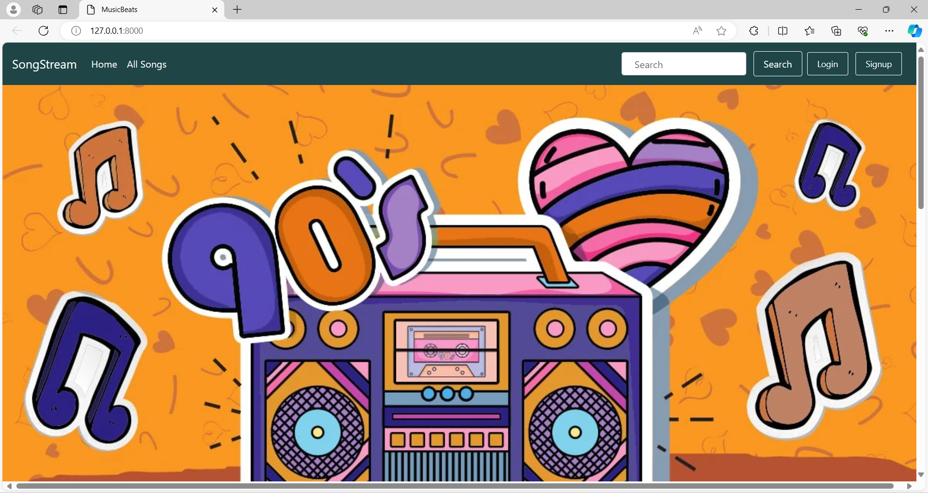
Home page

Slide 11
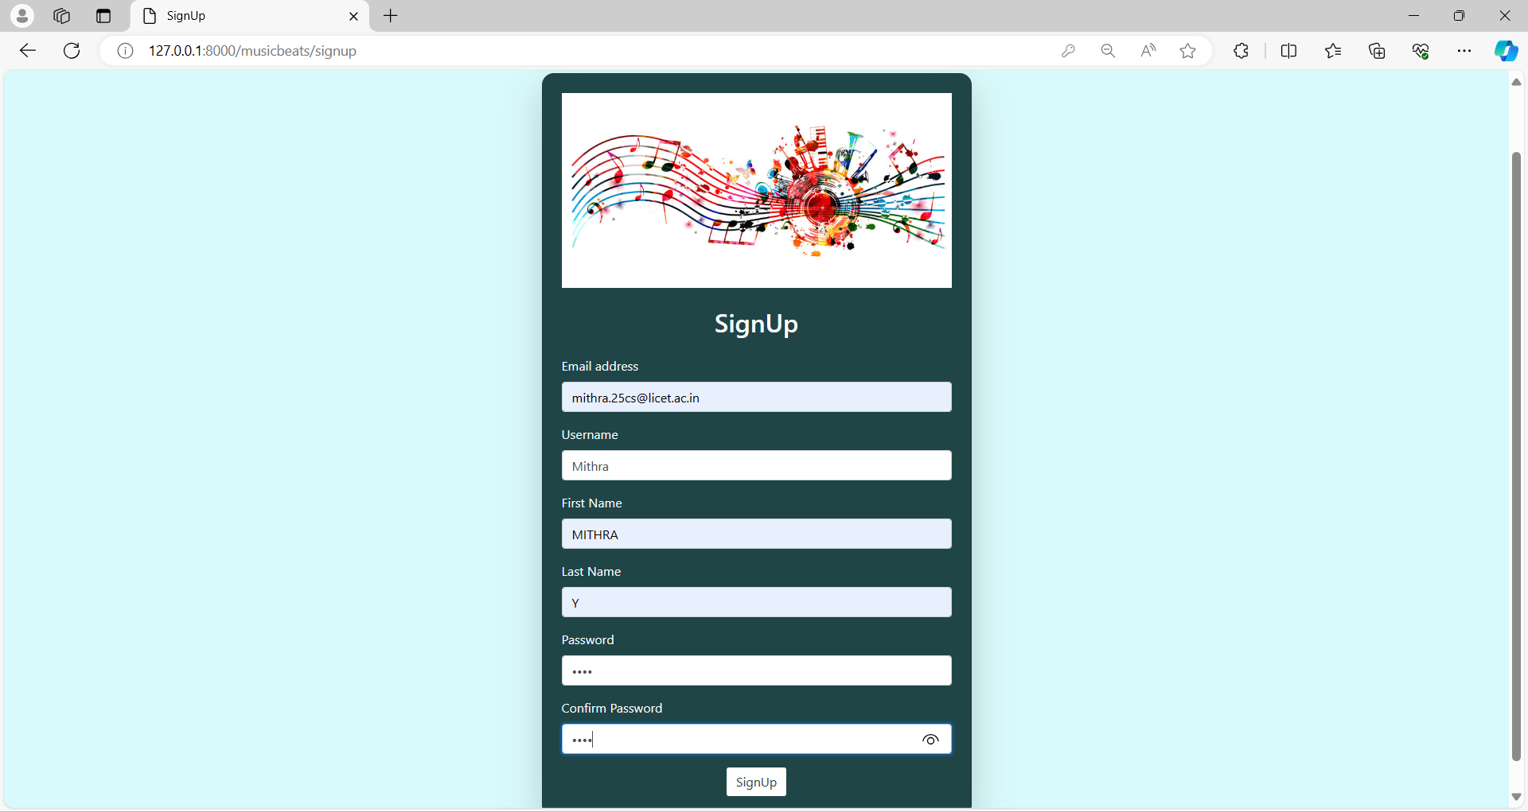
Sign Up Page
Source :

Slide 12
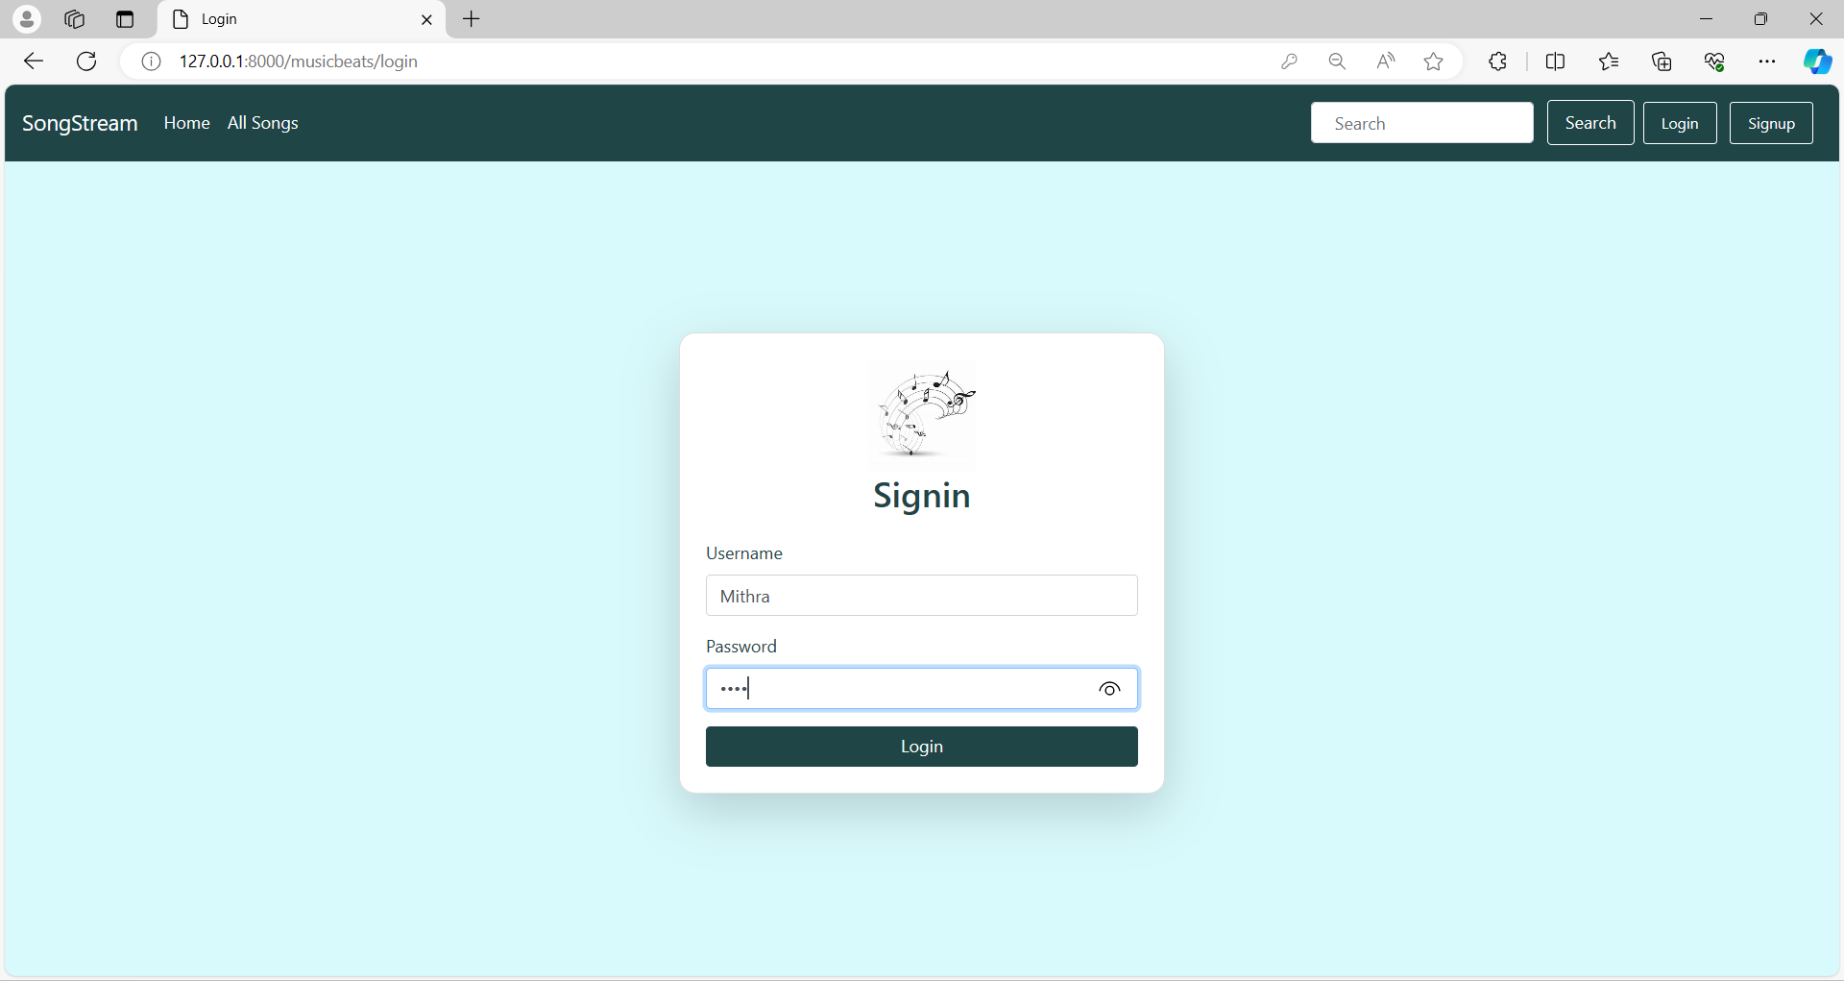
Login Page
Source :

Slide 13
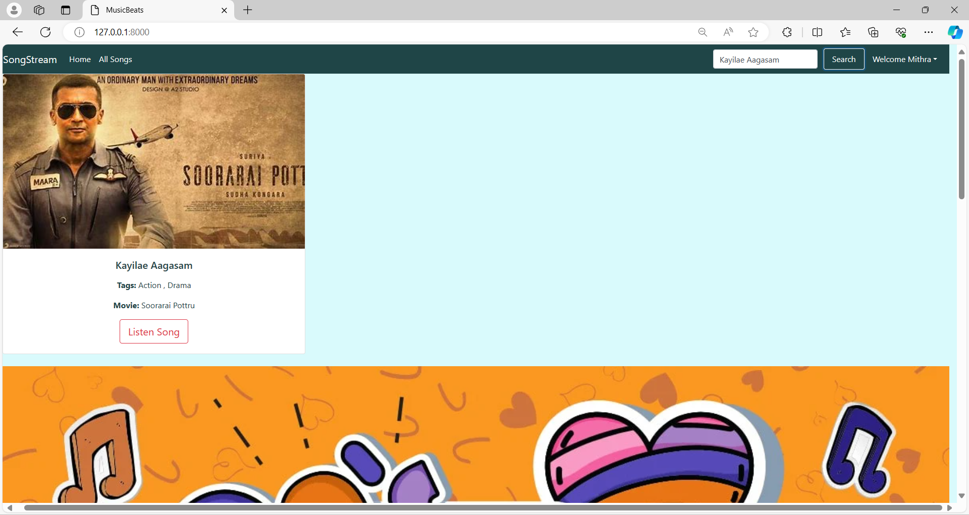
Search Bar
Source :

Slide 14
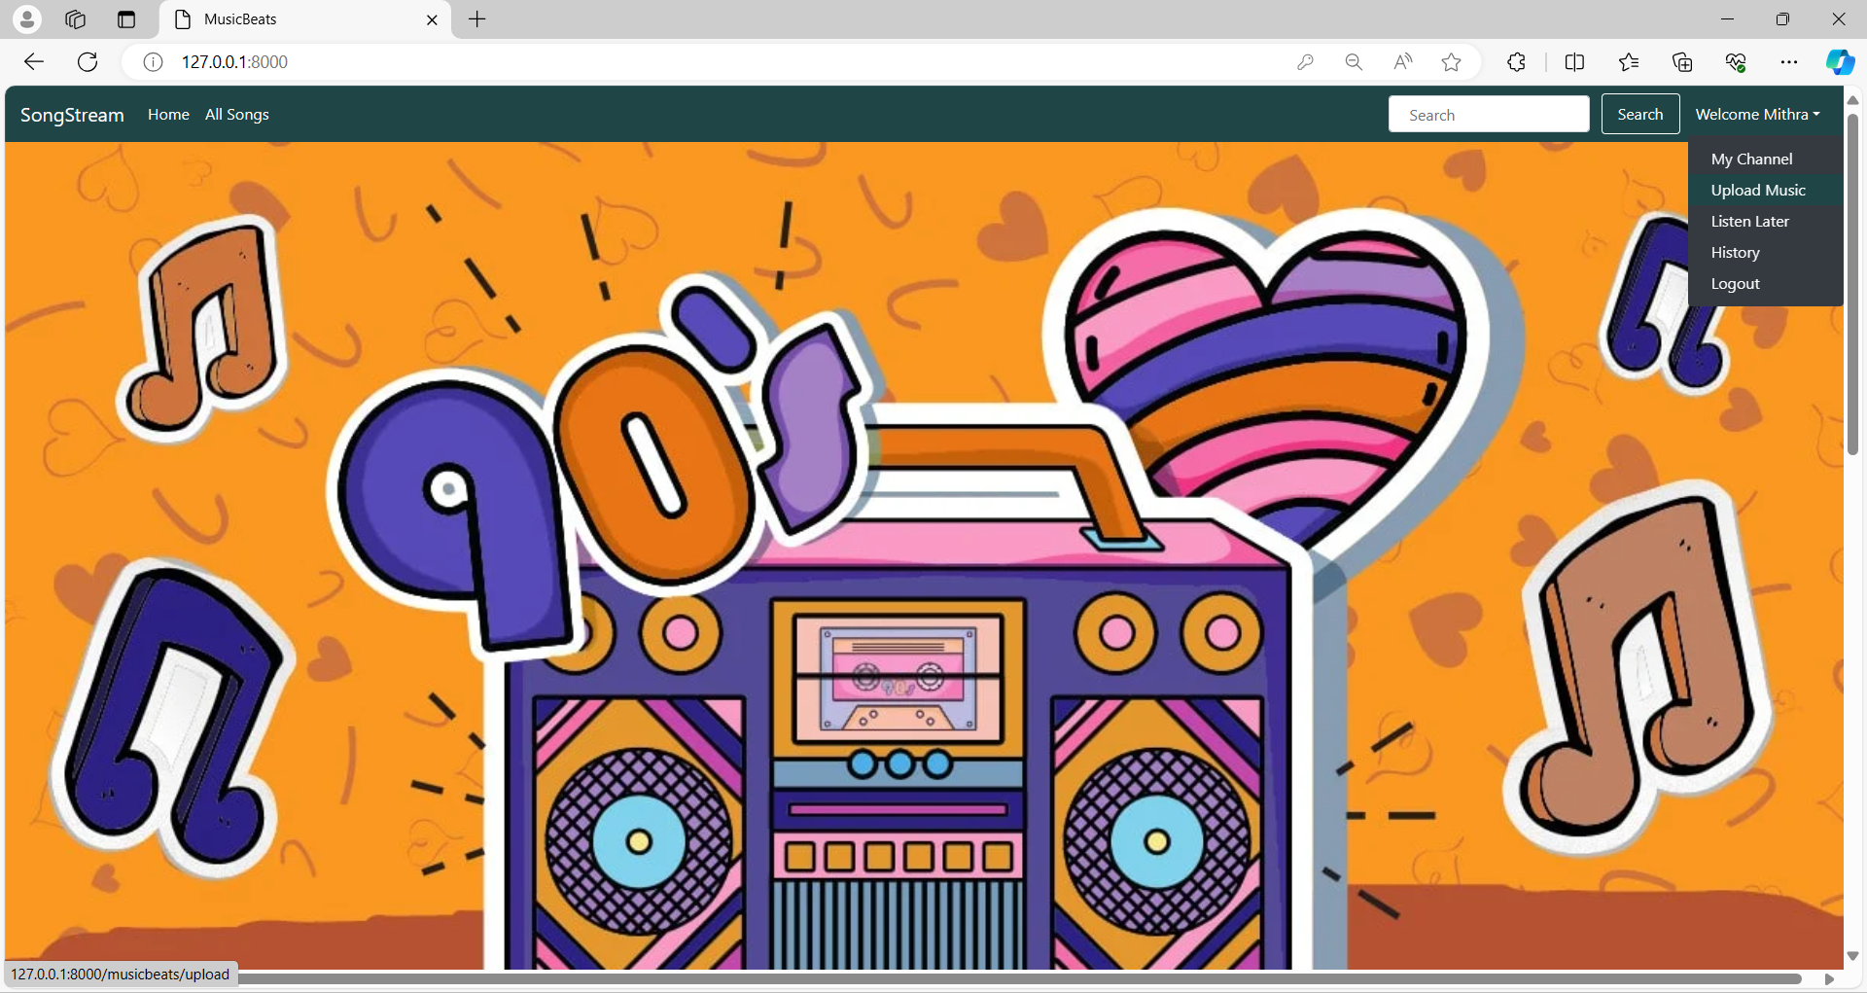
Drop Down Menu
Source :

Slide 15
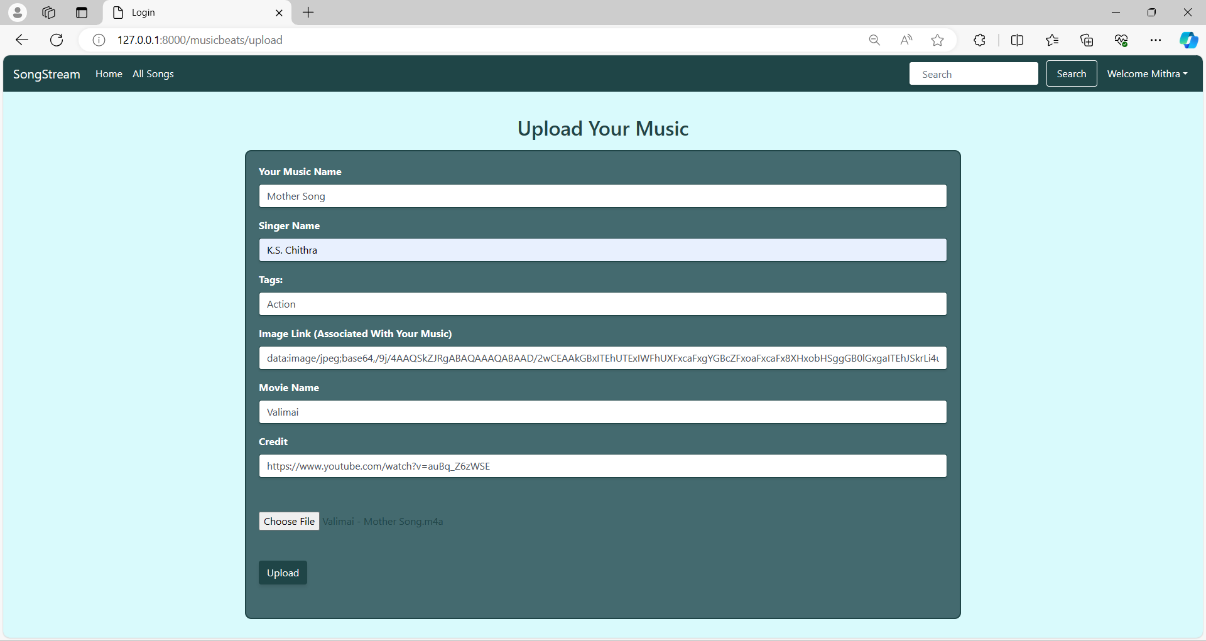
Upload Page
Source :

Slide 16
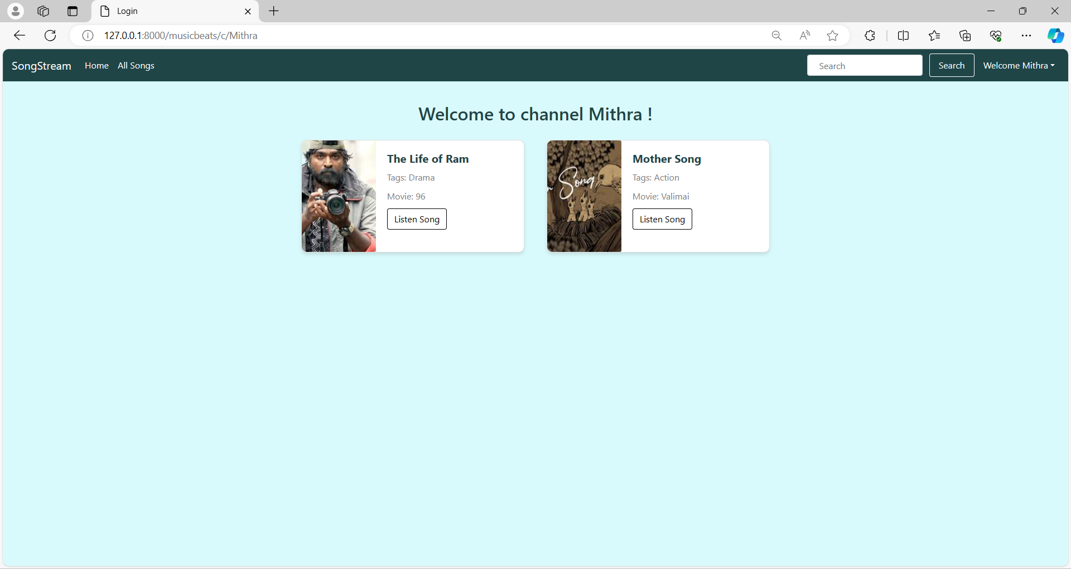
Channel Page
Source :

Slide 17
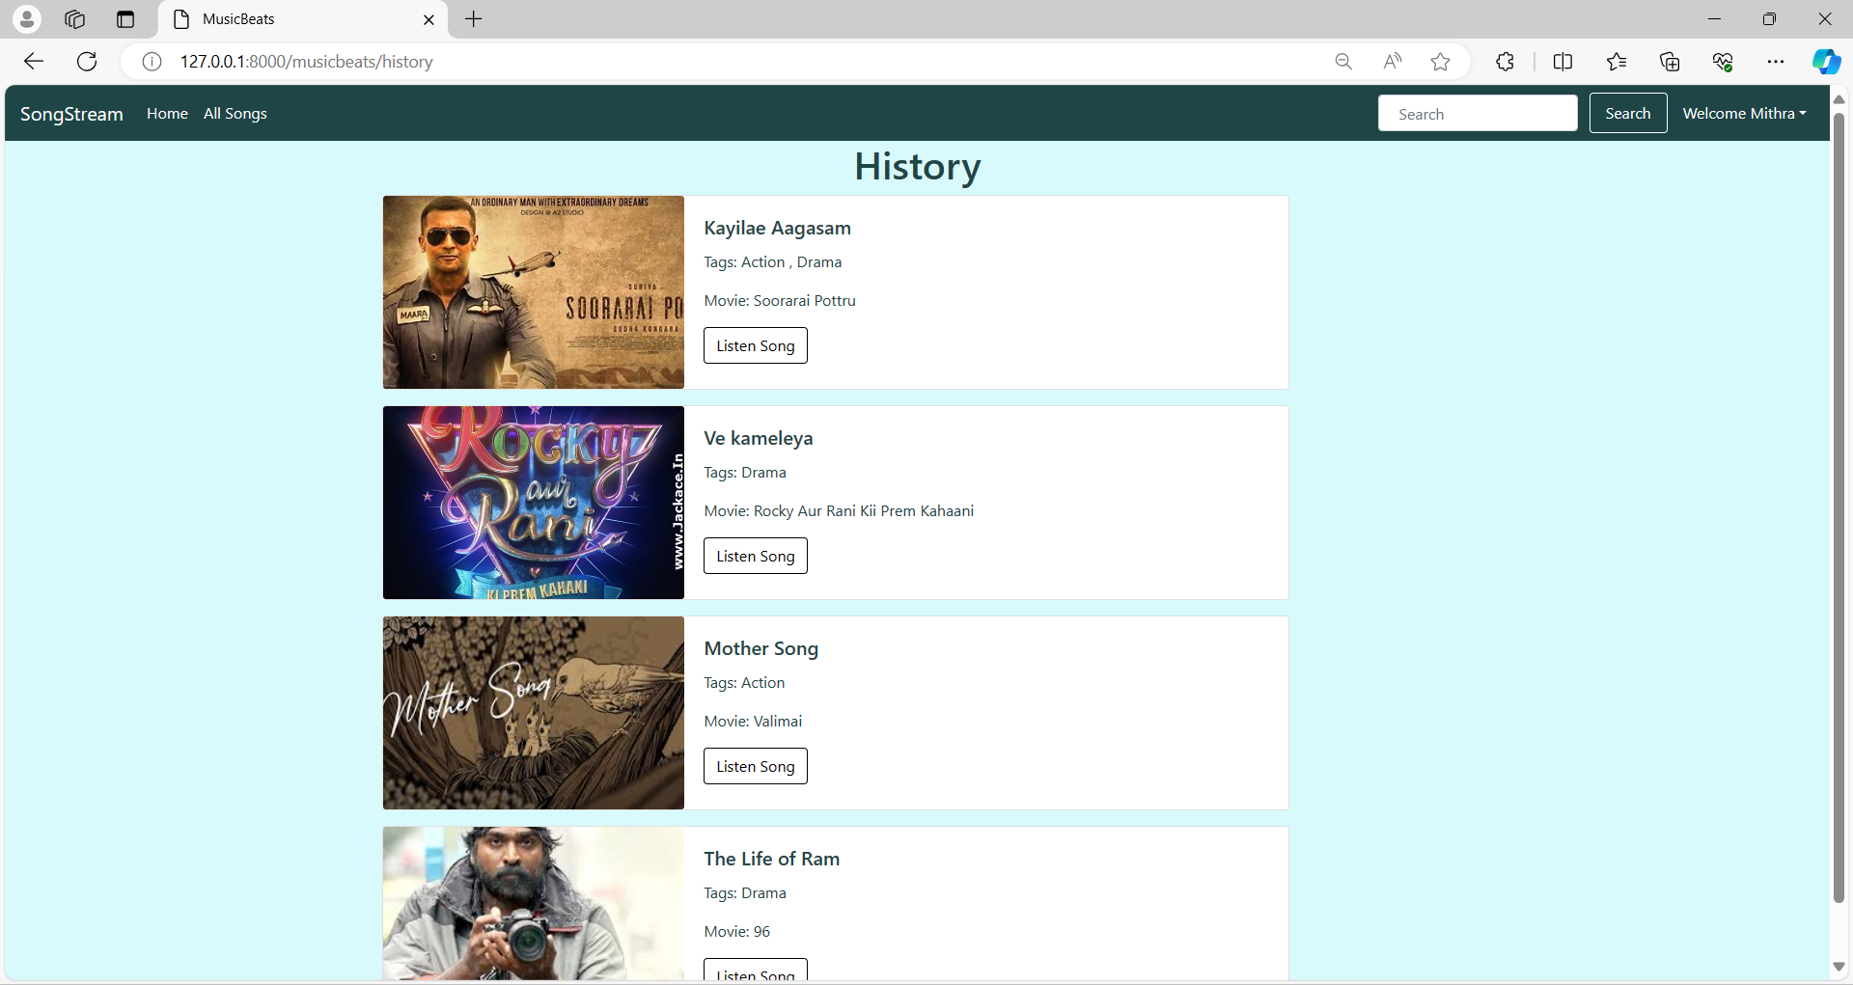
History page
Source :

Slide 18
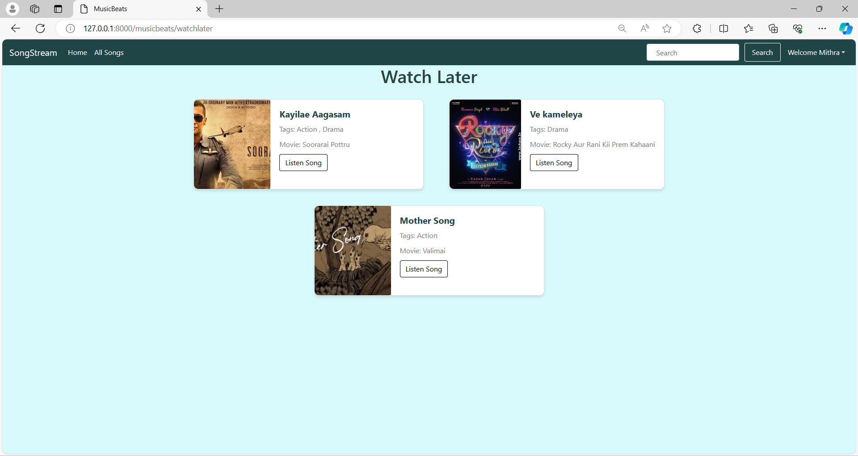
Watch Later Page
Source :

Slide 19
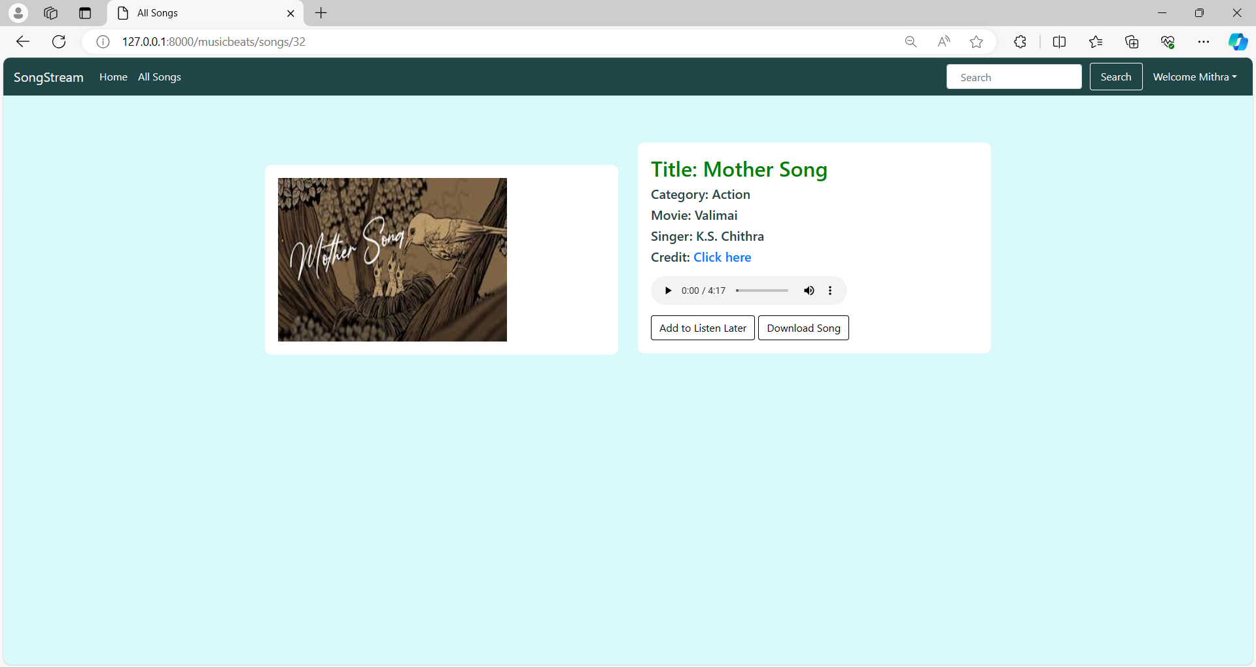
Song page
Source :

Slide 20
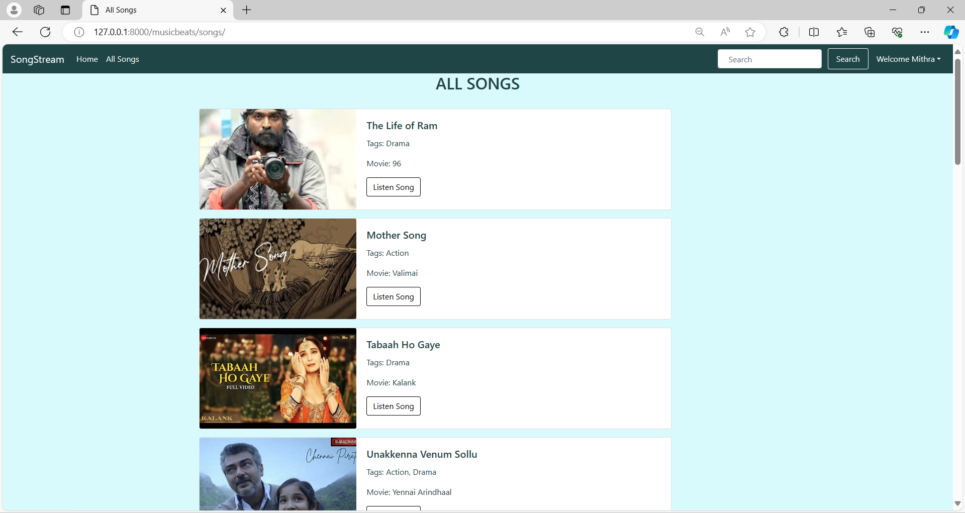
All Songs
Source :

Slide 21
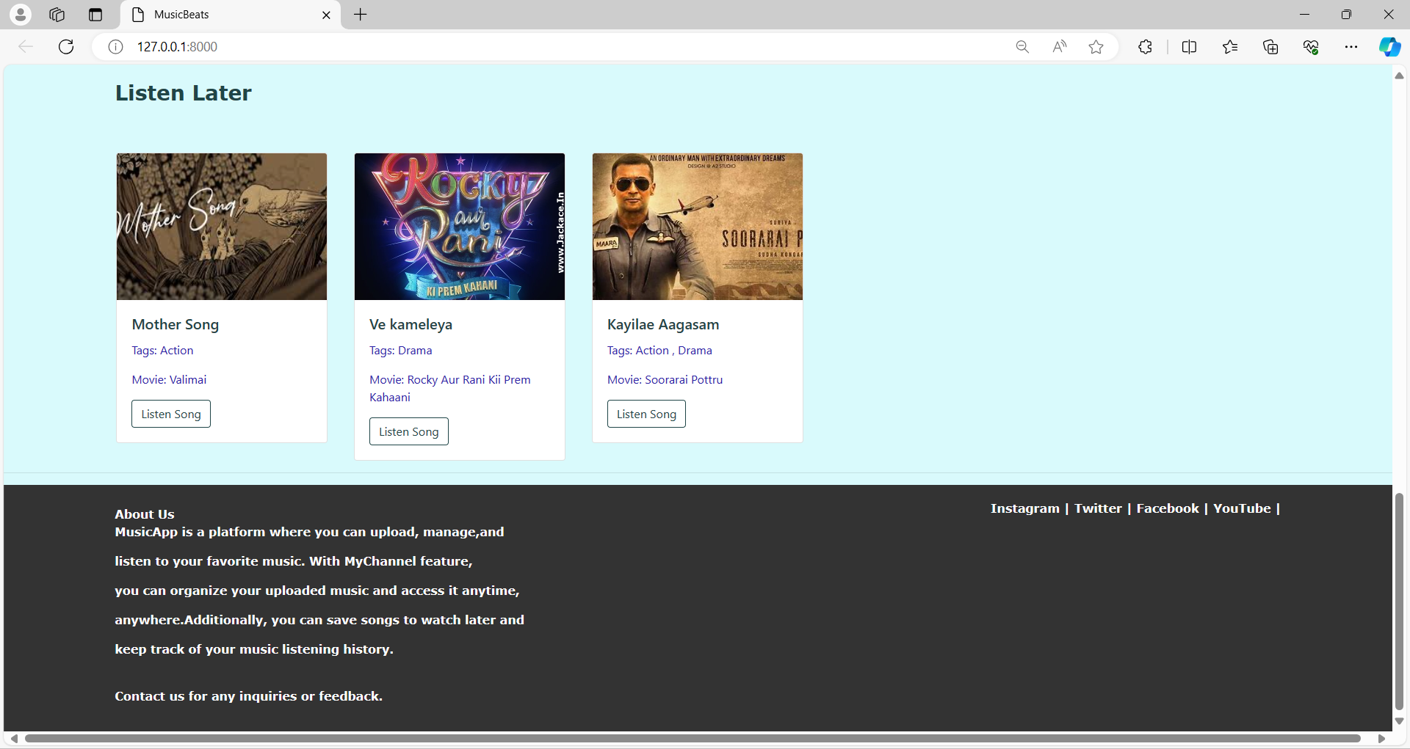
About-Us Page

Slide 22
Future Enhancements:
->Social Features: Enable user interactions like following, liking, and sharing to foster community engagement. -> Advanced Recommendations: Integrate machine learning for personalized music suggestions based on user behavior. -> Streaming Capability: Add real-time streaming for instant access to music content without downloads. -> Enhanced Search: Improve search with advanced filters and autocomplete for quicker song discovery. -> Offline Mode: Develop offline access for users to download songs and playlists for offline listening. -> Multi-platform Support: Extend compatibility to mobile and desktop platforms for a seamless experience. -> Monetization Options: Explore subscription models, premium features, or ads for revenue generation. -> User Analytics: Implement analytics for insights into user behavior and content optimization. -> Accessibility Features: Ensure compliance with accessibility standards for inclusivity. -> Performance Optimization: Continuously optimize performance, scalability, and security for a smooth user experience.

Slide 23
Conclusion
Our music web application is designed to make it easy for users to enjoy and manage their music online. With features like uploading songs, creating playlists, and seeing what's trending, we've created a platform that's user-friendly and reliable. By using Django and other technologies, we've made sure it's secure and scalable. Overall, it's a convenient way for music lovers to enjoy their favorite tunes hassle-free.
Source :

Slide 24
Thank You!
Notes:
Thank You !!

